Slide 1

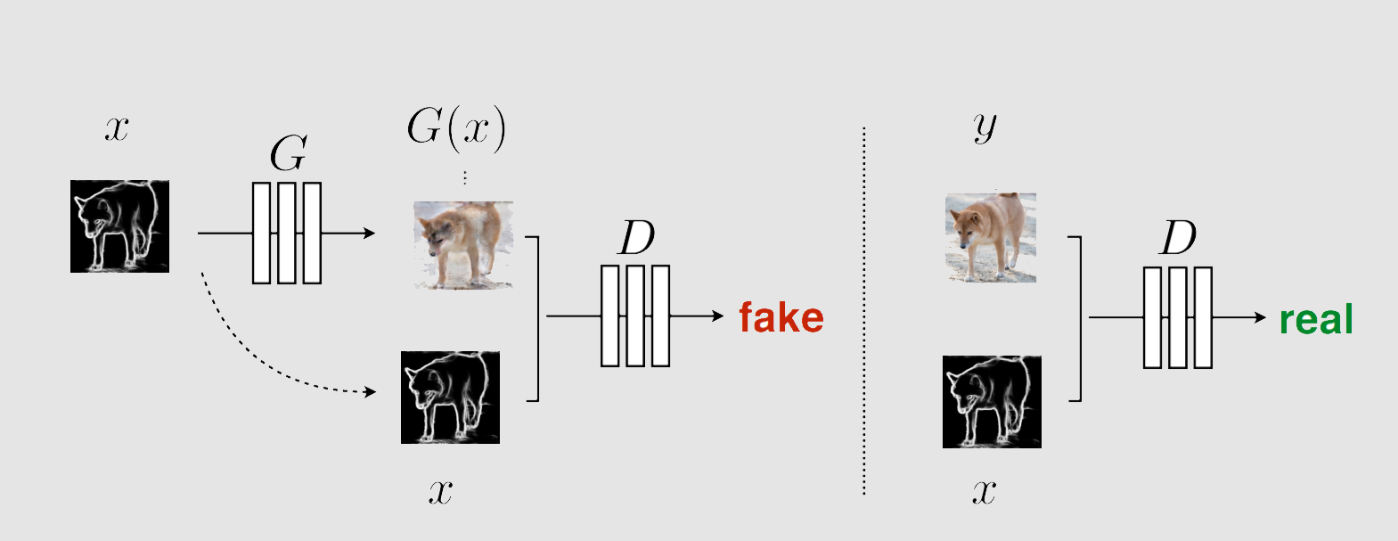
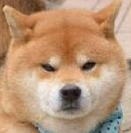
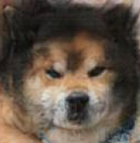
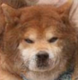
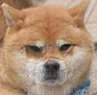
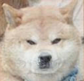
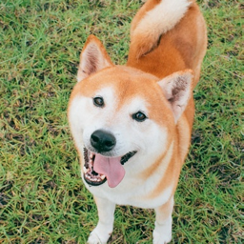
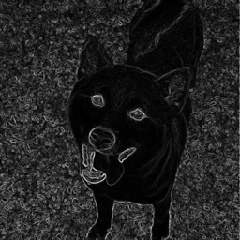
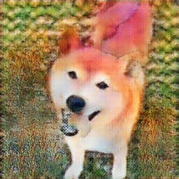
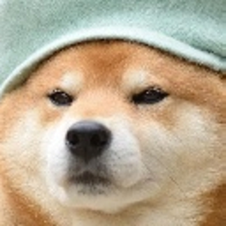
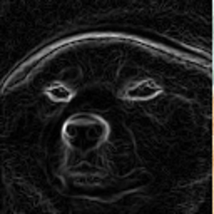
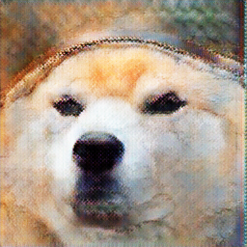
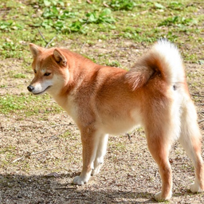
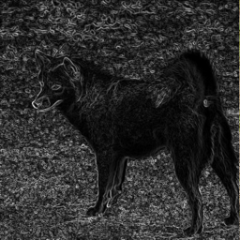
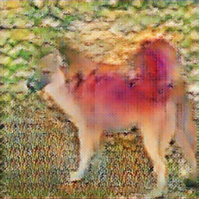

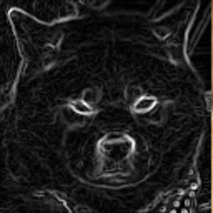
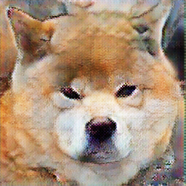
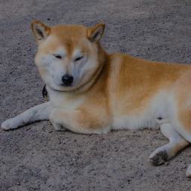
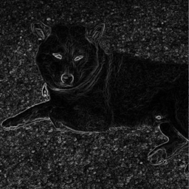
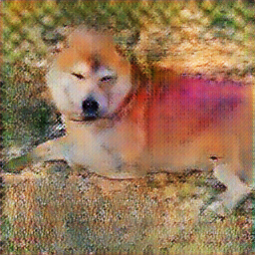
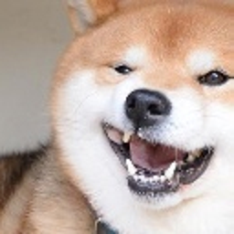
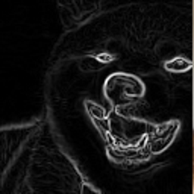
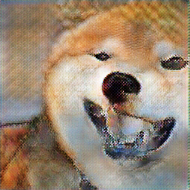
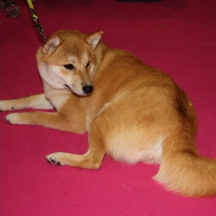
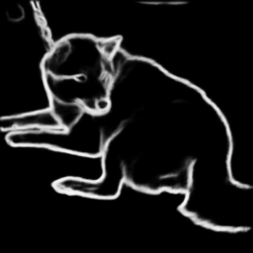
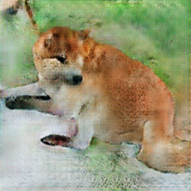
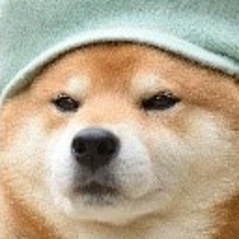
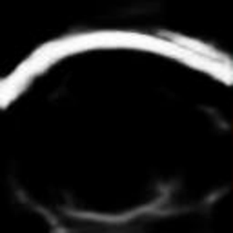
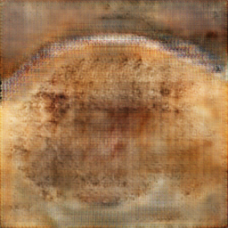
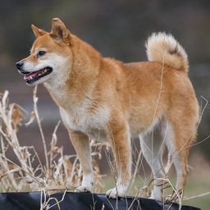
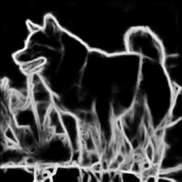
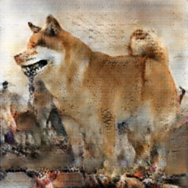

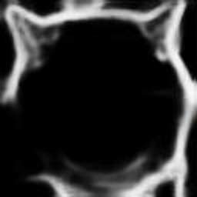
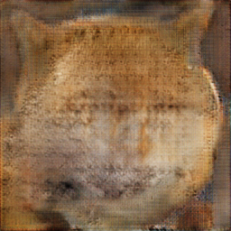
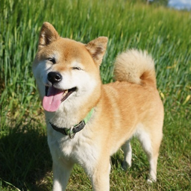
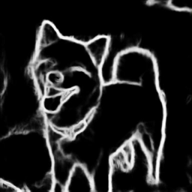
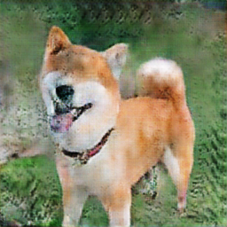

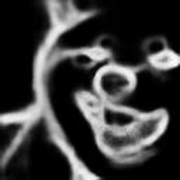
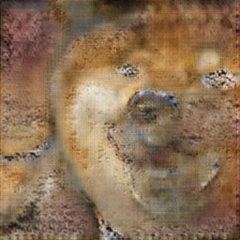
Dog GANs
Hung Lo, Shengjian Chen | Computer Vision CSE455 Autumn 2019 | University of Washington
Abstract
Pix2Pix with Edges
Other GANs
In this final project, we firstly build a small dataset of Shiba Inu with around 300 images
Then we explore different GANs to get some reasonable result from this small dataset.
To make use of our small dataset. One way we can think about is to provide extract information. For example, edges. Network is the same as the original Pix2Pix paper.
AttGAN
This GAN is usually used for human facial expression editing. We find that some attributes can be transferred to dogs.
input
black hair
brown hair
eyeglasses
pale skin
Dataset
SinGAN
SinGAN goes to an extreme to train GAN with single image. But we find it doesn’t work well on our images. We also try to extend single image to multiple images but see no improvement.
The first Part of the dataset are crawled from Flickr with the whole body and different backgrounds. The second part are from the same dog on Ins with only face on images. All the images are manually cropped to 128*128.
We try two kind of edge detection methods. One is Holistically-Nested Edge Detection (Hed) used in the original paper. The other one is Canny detector discussed on class.
Here is some result from different edge detectors and categories of dog images.
Whole body
face
Canny detector
Discussion
In Pix2Pix, Hed edge detector works well on capturing dog’s whole body but misses facial detail. We can try to combine Hed and Canny to produce better pix2pix result
We get relatively good results from pix2pix but more exploration is needed for other GANs.
DCGAN
We firstly try a simple DCGAN as a baseline. This GAN can only generate low quality dogs.
Hed detector
References
P. Isola, J.-Y. Zhu, T. Zhou, and A. A. Efros. Image-to-image translation with conditional adversarial networks. In CVPR, 2017. 2
Zhenliang He, Wangmeng Zuo, Meina Kan, Shiguang Shan, and Xilin Chen. Arbitrary facial attribute editing: Only change what you want. arXiv:1711.10678, 2017. 2
Tamar Rott Shaham, Tali Dekel, and Tomer Michaeli. SinGAN: Learning generative model from a single natural image. In ICCV, 2019. 3
Try more out in our demo!

